Slide 1
qCMB intro part 2

Slide 2
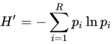
Shannon Diversity Index:
non-phylogenetic, alpha diversity metric measuring richness and evenness
FeatureTable[Frequency]
SampleData[AlphaDiversity]
 | feature1 | feature2 | feature3 | feature4 | feature5
4ac2 | 25 | 30 | 15 | 0 | 0
e375 | 0 | 17 | 33 | 25 | 0
 | Shannon
4ac2 | 1.061
e375 | 1.064
Notes:
Number of species is weighted by their evenness
In the Shannon index, p is the proportion (n/N) of individuals of one particular species found (n) divided by the total number of individuals found (N), ln is the natural log, Σ is the sum of the calculations, and s is the number of species.
So then IN order to get this proportion you need to know the total number of individuals.
=70 (4ac2)
= - [0.36(-1.03) + 0.43(-0.85)+ 0.21(-1.54)]
= -(-0.37 + -0.37 + -0.32)
= 1.06

Slide 3
Shannon Diversity Index:
non-phylogenetic, alpha diversity metric measuring richness and evenness
FeatureTable[Frequency]
SampleData[AlphaDiversity]
 | feature1 | feature2 | feature3 | feature4 | feature5
4ac2 | 25 | 30 | 15 | 0 | 0
e375 | 0 | 17 | 33 | 25 | 0
 | Shannon
4ac2 | 1.061
e375 | 1.064
4ac2
Feature 1: 25/70=0.357
Feature 2: 30/70= 0.429
Feature 3: 15/70=0.214
= - [0.36(-1.03) + 0.43(-0.85)+ 0.21(-1.54)]
= -(-0.371 + -0.367 + -0.323) = 1.061
Notes:
where p_{i} is the proportion of characters belonging to the ith type of letter in the string of interest. In ecology, p_{i} is often the proportion of individuals belonging to the ith species in the dataset of interest.
=70 (4ac2)
= 75 (e375)
Shannon’s assumes all species are represented and that they are randomly sampled – it tends to be sensitive to rare taxa. Typical values are generally between 1.5 and 3.5
Simpson’s index – gives more weight to dominant species, which can also be a problem if rare taxa are significant contributors.

Slide 4
Why incorporate phylogeny in a diversity metric?
FeatureTable[Frequency]
SampleData[AlphaDiversity]
 | feature1 | feature2 | feature3 | feature4 | feature5
4ac2 | 25 | 30 | 15 | 0 | 0
e375 | 0 | 17 | 33 | 25 | 0
 | Shannon
4ac2 | 1.061
e375 | 1.064
Phylogeny[Rooted]
FeatureData[Taxonomy]
0.5
feature1
feature2
feature3
feature4
feature5
 | Domain
feature1 | Bacteria
feature2 | Bacteria
feature3 | Bacteria
feature4 | Archaea
feature5 | Archaea
1.25
0.5
0.5
0.6
0.75
1.45
0.25
Notes:
4ac2 contains only bacteria while e375 contains archaea.. This difference is not evident by just looking at the Shannon diversity index.

Slide 5
Faith’s Phylogenetic Diversity (PD):
phylogenetic, alpha diversity metric measuring richness
FeatureTable[Frequency]
SampleData[AlphaDiversity]
 | feature1 | feature2 | feature3 | feature4 | feature5
4ac2 | 25 | 30 | 15 | 0 | 0
e375 | 0 | 17 | 33 | 25 | 0
 | Faith’s PD
4ac2
e375
Phylogeny[Rooted]
0.5
feature1
feature2
feature3
feature4
feature5
Sum of branch length covered by a sample.
1.25
0.5
0.5
0.6
0.75
1.45
Faith DP (1992) Conservation evaluation and phylogenetic diversity. Biological Conservation. 61:1-10.
0.25

Slide 6
Faith’s Phylogenetic Diversity (PD):
phylogenetic, alpha diversity metric measuring richness
FeatureTable[Frequency]
SampleData[AlphaDiversity]
 | feature1 | feature2 | feature3 | feature4 | feature5
4ac2 | 25 | 30 | 15 | 0 | 0
e375 | 0 | 17 | 33 | 25 | 0
 | Faith’s PD
4ac2 | 3.35
e375 | 5.05
Phylogeny[Rooted]
0.5
feature1
feature2
feature3
feature4
feature5
Sum of branch length covered by a sample.
1.25
0.5
0.5
0.6
4ac2 =1.25+0.5+0.5+0.5+0.6 = 3.35
0.75
1.45
Faith DP (1992) Conservation evaluation and phylogenetic diversity. Biological Conservation. 61:1-10.
0.25
Notes:
Walk through the math
Add them up, just once each
Only takes into account phylogenetic distance, not the frequency and so it measures phylogenetic richness
Alpha div - common to report more than one metric e.g. Shannonn, PD

Slide 7
Alpha diversity comparison
visually with distribution comparison plots (discrete data) or scatter plots (continuous data)
statistically with Kruskal-Wallis (discrete data) or Spearman correlation (continuous data)
Notes:
Have them open qzv in qiime2view
Non-parametric
We will do this on Friday

Slide 8
What are the most diverse environments?
Thompson et al. 2017, Nature
Notes:
What types of factors may be driving diversity in these environments? Can you think of a few?
Factors that increase niche availability (related to combination or limitations on growth)
diverse resources?
increased space?
disturbance events / environmental fluctuations?
chronically extreme conditions?
Skin disturbances – cleaning, temperature
Gut disturbances – pharmaceuticals, diet

Slide 9
End Day 1

Slide 10
Microbiome Science amplicon sequencing analysis
qCMB Introduction
Wednesday, April 27, 2022

Slide 11
Comparing microbial communities
How many different OTUs/ASVs are there? Alpha diversity
How similar are pairs of samples? Beta diversity
Who is there? Taxonomic profiling, differential abundance testing

Slide 12
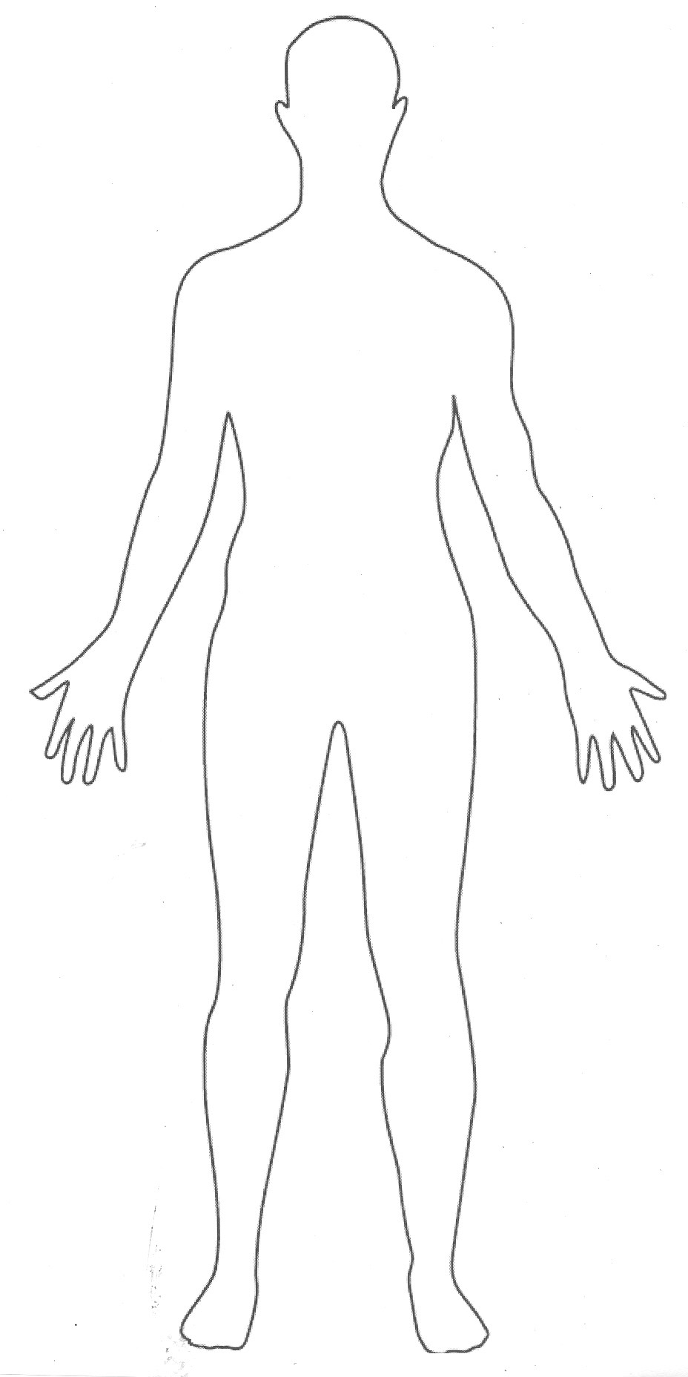
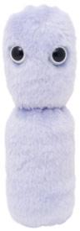
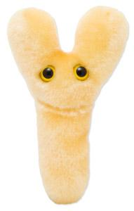
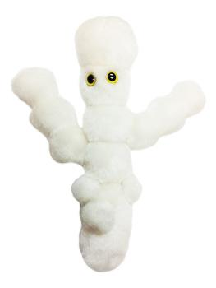
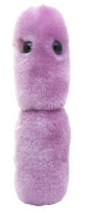
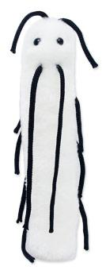
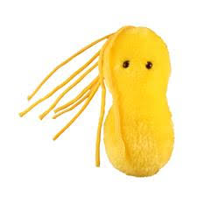
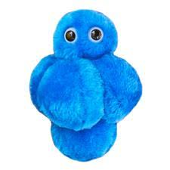
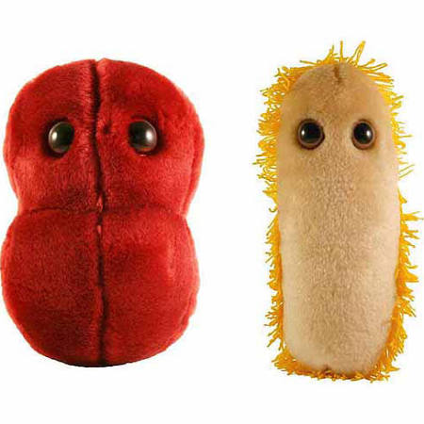
Alpha diversity: number of types of microbes
Notes:
Left richness would be 2 vs 9

Slide 13
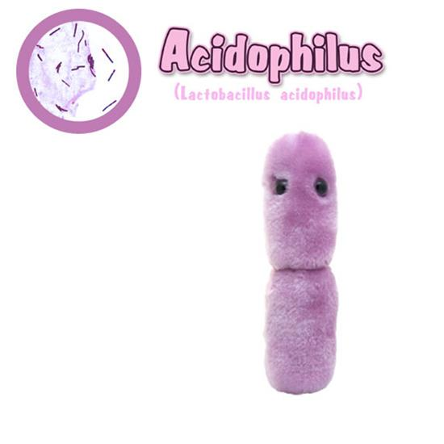
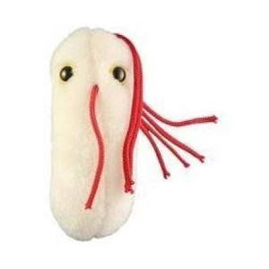
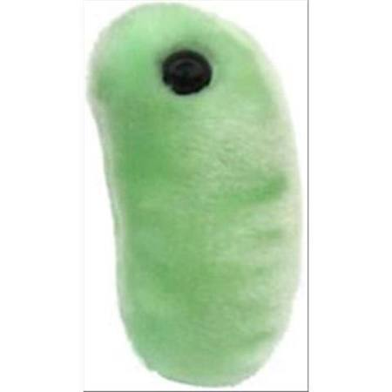
Beta diversity: difference between communities
Notes:
Measured by distance. Different metrics to estimate this distance
Compare each pair

Slide 14
Beta diversity: difference between communities
High
Low
High
Notes:
Two samples exact same microbes, distance 0
Similar to alpha diversity, there’s different ways to estimate distance. It can include phylogeny, it can include the relative abundance

Slide 15
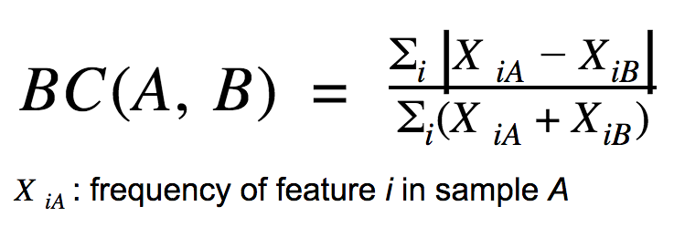
Bray-Curtis distance: non-phylogenetic beta diversity metric
FeatureTable[Frequency]
 | feature1 | feature2 | feature3 | feature4 | feature5
4ac2 | 42 | 0 | 37 | 99 | 1
e375 | 12 | 1 | 22 | 88 | 0
4gd8 | 25 | 3 | 23 | 86 | 0
9872 | 0 | 0 | 87 | 12 | 0
DistanceMatrix
 | 4ac2 | e375 | 4gd8 | 9872
4ac2 | 0.0
e375 | 0.19 | 0.0
4gd8 | 0.15 | 0.07 | 0.0
9872 | 0.65 | 0.69 | 0.70 | 0.0
30+1+15+11+1 = 58
54+1+59+187+1 = 302
=58/302 = 0.19
Notes:
Small top, smaller number = close to 0, very similar
Bottom sort of scales it. 58 differences over 100 vs 1000

Slide 16
Bray-Curtis distance: non-phylogenetic beta diversity metric
FeatureTable[Frequency]
 | feature1 | feature2 | feature3 | feature4 | feature5
4ac2 | 42 | 0 | 37 | 99 | 1
e375 | 12 | 1 | 22 | 88 | 0
4gd8 | 25 | 3 | 23 | 86 | 0
9872 | 0 | 0 | 87 | 12 | 0
DistanceMatrix
 | 4ac2 | e375 | 4gd8 | 9872
4ac2 | 0.0 | 0.19 | 0.15 | 0.65
e375 | 0.19 | 0.0 | 0.07 | 0.69
4gd8 | 0.15 | 0.07 | 0.0 | 0.70
9872 | 0.65 | 0.69 | 0.70 | 0.0
Notes:
And this makes a symmetric distance matrix. Comparison of sample A to B same as B to A

Slide 17
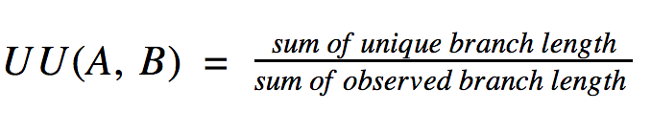
Unweighted UniFrac distance: phylogenetic beta diversity metric
FeatureTable[Frequency]
 | feature1 | feature2 | feature3 | feature4 | feature5
4ac2 | 42 | 0 | 37 | 99 | 1
e375 | 12 | 1 | 22 | 88 | 0
4gd8 | 25 | 3 | 23 | 86 | 0
9872 | 0 | 0 | 87 | 12 | 0
Phylogeny[Rooted]
DistanceMatrix
0.5
feature1
feature2
feature3
feature4
feature5
 | 4ac2 | e375 | 4gd8 | 9872
4ac2 | 0.0
e375 |  | 0.0
4gd8 |  |  | 0.0
9872 |  |  |  | 0.0
1.25
0.5
0.5
0.6
0.75
1.45
0.25
Notes:
Sum of unique 0.75
=1.25+.5+.5+.5+.6+1.45+.75 + 0.25= 5.8
0.75/5.8 =0.13

Slide 18
Unweighted UniFrac distance: phylogenetic beta diversity metric
FeatureTable[Frequency]
 | feature1 | feature2 | feature3 | feature4 | feature5
4ac2 | 42 | 0 | 37 | 99 | 1
e375 | 12 | 1 | 22 | 88 | 0
4gd8 | 25 | 3 | 23 | 86 | 0
9872 | 0 | 0 | 87 | 12 | 0
Sum of unique 0.75
=1.25+.5+.5+.5+.6+1.45+.75 + 0.25= 5.8
0.75/5.8 =0.13
Phylogeny[Rooted]
DistanceMatrix
0.5
feature1
feature2
feature3
feature4
feature5
 | 4ac2 | e375 | 4gd8 | 9872
4ac2 | 0.0
e375 |  | 0.0
4gd8 |  |  | 0.0
9872 |  |  |  | 0.0
1.25
0.5
0.5
0.6
0.75
1.45
0.25
Notes:
Sum of unique 0.75
=1.25+.5+.5+.5+.6+1.45+.75 + 0.25= 5.8
0.75/5.8 =0.13

Slide 19
Unweighted UniFrac distance: phylogenetic beta diversity metric
FeatureTable[Frequency]
 | feature1 | feature2 | feature3 | feature4 | feature5
4ac2 | 42 | 0 | 37 | 99 | 1
e375 | 12 | 1 | 22 | 88 | 0
4gd8 | 25 | 3 | 23 | 86 | 0
9872 | 0 | 0 | 87 | 12 | 0
Phylogeny[Rooted]
DistanceMatrix
0.5
feature1
feature2
feature3
feature4
feature5
 | 4ac2 | e375 | 4gd8 | 9872
4ac2 | 0.0 | 0.13 | 0.13 | 0.14
e375 | 0.13 | 0.0 | 0.0 | 0.18
4gd8 | 0.13 | 0.0 | 0.0 | 0.18
9872 | 0.14 | 0.18 | 0.18 | 0.0
1.25
0.5
0.5
0.6
0.75
1.45
0.25
Notes:
Do this for each sample comparison, again symmetrical distance matrix

Slide 20

PCoA: visualize beta diversity, unweighted Unifrac
PC2 – 5%
PC1 – 15%
Notes:
Gut microbiome of human populations across the globe.
By lifestyle PC!
Then can use a statistical test such as permanova to see if there is a significant difference

Slide 21
Normalizing for sequencing depth
Diversity metrics are often impacted by the total number of sequences observed in samples
e.g. two samples can appear more similar just because they have similar sequencing depth..
fecal 1 – 100 reads
fecal 2 – 20,0000 reads
skin 1 – 105 reads
skin 2 – 17,000 reads
So we need to normalize the reads somehow
Observed ASVs
Fecal 2
Skin 2
Fecal 1
Skin 1

Slide 22
beta-group-significance
PERMANOVA - multivariate analysis of variance to determine significant difference between groups. Null = the centroids and dispersion of the groups as defined by measure space are equivalent for all groups.
Adonis allows for more than a one-way (multifactor) permanova
PERMDISP – used in conjunction with PERMANOVA. Null hypothesis: dispersion is equivalent
Notes:
Perm disp can help tease out whether a significance in Permanova is due to dispersion vs centroid (or both)

Slide 23
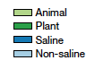
Earth Microbiome Project
EMPO level 3
EMPO level 2
Thompson et al. 2017, Nature
Notes:
The Earth Microbiome project was a much more recent big effort to characterize and compare microbial ecologies of diverse sample types
Participant were able to submit samples or data as long as they followed standard protocols (primers, etc) and submitted the standard metadata
This allowed for a really large number of samples to be compared. Meta-analysis combined over 100 studies, about half of which were also published separately, a little over 27k samples
We also looked at some of the results of this study in the alpha diversity lecture
Here on the left, we recapitulate the findings of Ley et al 2008, where host associated vs freeliving is one major split.
Machine learning 91% accuracy
On the right, it is the same data but colored by more specific catagories

Slide 24
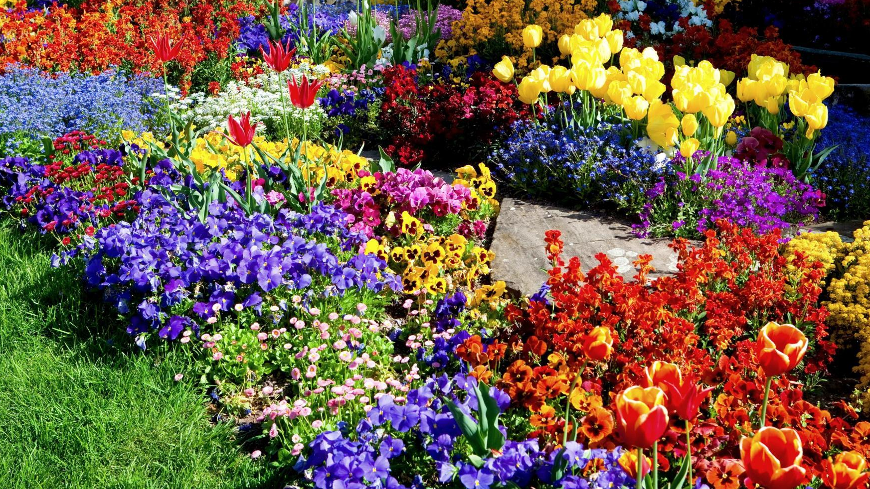
Why might diversity be important?
Diversity of microbes can be related to diversity of function
Notes:
So, one of the reasons we might be interested in diversity is that it can relate to function

Slide 25
ITS
16S rRNA
16S rRNA
shotgun
Leff et al. 2015
Notes:
25 globally distributed grassland sites
Pcoa of amplicon sequencing as well as functional genes from soil plots that were part of experiments in which Nitrogena nd P were added.
Blue – Nitrogen added, red = P added
Permanova significant
Mycorrhizal fungi decreasing (delivers nutrients to plants), archaeal community capable of ammonia oxidation,
shift bacterial communities to favor copiotrophic over more oligotrophic taxa.
Did not show % variation

Slide 26
Muegge et al. 2012
Notes:
Within mammalian gut, diet drives some of the major patterns of microbial community similarity,
OUT network, don’t really use anymore

Slide 27
Notes:
Diet mostly influences the acquisition of ancient and major microbial lineages – such as Firmicutes, Bacteroidetes. Conversely, correlation with host phylogeny is mostly seen among more recently diverged bacterial lineages, consistent with processes operating at similar timescales to host evolution. Phylogenetic analyses support co-speciation as having a significant role in the evolution of mammalian gut microbiome compositions
As you can imagine there is likely some dispersal limitation to microbes in the mammalian gut. A possum and a deer prob don’t exchange microbes easily

Slide 28
What does it mean when we see a lack of beta diversity pattern?

Slide 29
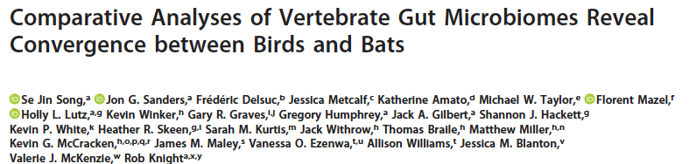
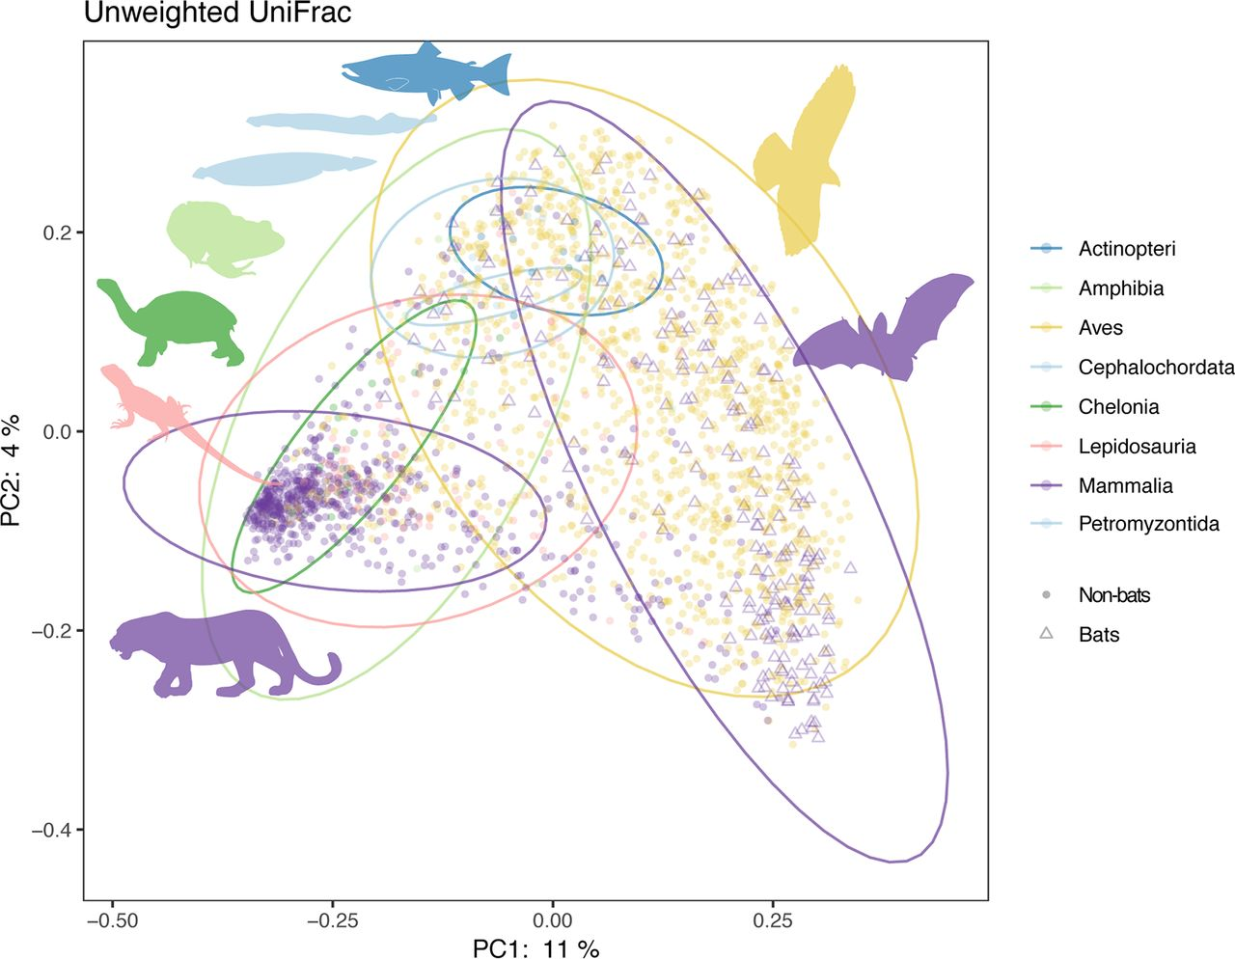
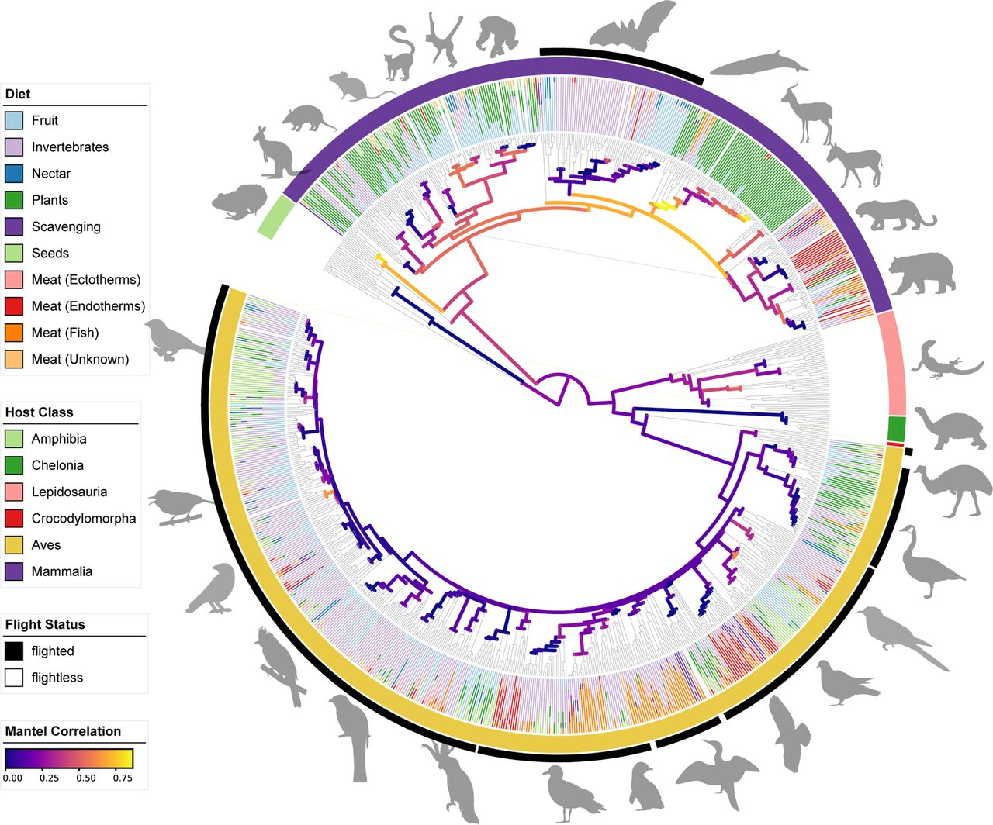
Notes:
~900 vert species, 350 mammals, ~ 500 birds
Left – host tree colored by diet, Right unweighted unifrac colored by host class
In birds, by contrast, gut microbiomes are only very weakly correlated to diet or host phylogeny. Further-
more, while most microbes resident in mammalian guts are present in only a restricted
taxonomic range of hosts, most microbes recovered from birds show little
evidence of host specificity. Notably, among the mammals, bats host especially birdlike
gut microbiomes,
Birds and bats both tend to have reduced intestinal lengths and shorter intestinal content retention times, perhaps as a by-product of selective pressure to decrease mass f

Slide 30
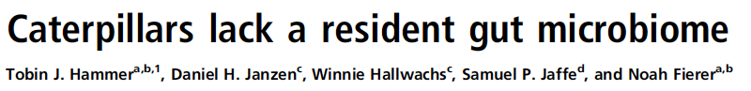
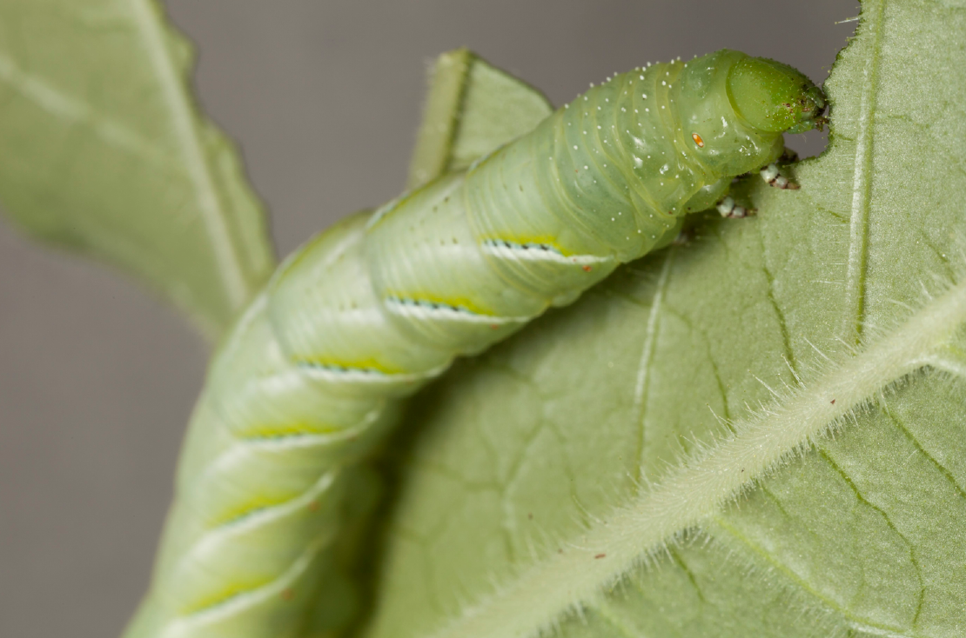
Notes:
The high
pH, simple gut structure, and fast transit times that typify caterpillar
digestive physiology may prevent microbial colonization. Moreover,
host-encoded digestive and detoxification mechanisms likely render
microbes unnecessary for caterpillar herbivory.

Slide 31
Comparing microbial communities
How many different OTUs/ASVs are there? Alpha diversity
How similar are pairs of samples? Beta diversity
Who is there? Taxonomic profiling, differential abundance testing

Slide 32
Data that are naturally described as proportions or probabilities, or with a constant or irrelevant sum, are referred to as compositional data.
Notes:
Start with a definition
Sequencing depth is the irrelevant sum

Slide 33
What do these taxa plots really tell us?
control soils
decomposition soils
100%
0%
time
time of decomposition
Metcalf et al. 2016
Notes:
Here we look at a taxa plot and want to conclude something. Firmicutes increased as decomposition progresses. But a little more complicated than that

Slide 34
Compositionality
Red doubled
Cannot determine which is actually changing
Proportions | 1/2 | 1/2
Counts | 100 | 100
Proportions | 2/3 | 1/3
Counts | 200 | 100
Blue halved
Proportions | 1/2 | 1/2
Counts | 100 | 100
Proportions | 2/3 | 1/3
Counts | 100 | 50
Time point 1
Time point 2
Notes:
Walk through.

Slide 35
Differential abundance testing is imperfect
Issues of compositionality and a lot of zeros
Notes:
Tools have been developed to try to determine if taxa are differential abundance across treatments, etc. These are imperfect and suffer both from limits due to compositionality but also the sparseness of the microbiome data set

Slide 36
Non-parametric tests are problematic
e.g. Mann-Whitney/Wilcoxon rank-sum test for tests of two groups; the Kruskal-Wallis test for tests of multiple group
These don’t account for compositionality of amplicon sequencing data
Notes:
In older microbiome papers, you may see something like a KW test to determine if one taxa is significantly increased in relative abundance compared to another treatment
These aren’t really valid due to the reasons of compositionality we just explained.

Slide 37
ANCOM
Notes:
One of the first widely used approaches which was published in 2015 is called ANCOM, for detecting differences in microbial mean
taxa abundance.
Basically works by comparing ratios of microbial abundances across your variable, and then finding the microbes that are in significantly different ratios the most

Slide 38
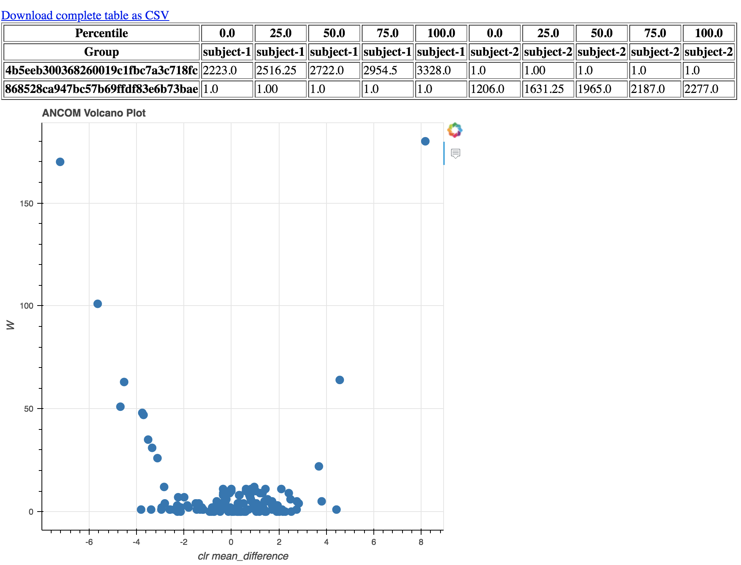
ANCOM – Analysis of Compositions of Microbiomes
W= # of hypotheses rejected
The higher the number, the more likely it’s a real difference
clr mean_difference (F-statistic) = magnitude of difference
If near zero, not that impressive
Notes:
An output of Ancom is a volcano plot.. W on y-axis and magnitude of difference on the x
There are two features that stand out here with high W and large effect size

Slide 39
Notes:
A few other methods used to identify differentially abundant or enriched taxa. One is co-opting deseq2 which was developed for rna seq data, balance trees – ratio type approach
Weiss – paper, go to next slide.

Slide 40
DESeq2 provides increased sensitivity on smaller datasets (<20 samples per group); however, it tends towards a higher false discovery rate with larger and/or very uneven library sizes
ANCOM has very low FDR and comparable power to other methods, but sensitivity is decreased for smaller data sets
Notes:
deseq2 has isses with high false discovery as data sets get larger or if there are very uneven library sizes. Log ratio and negative binomial approaches promising

Slide 41
Can I predict metadata from microbial abundances?

Slide 42
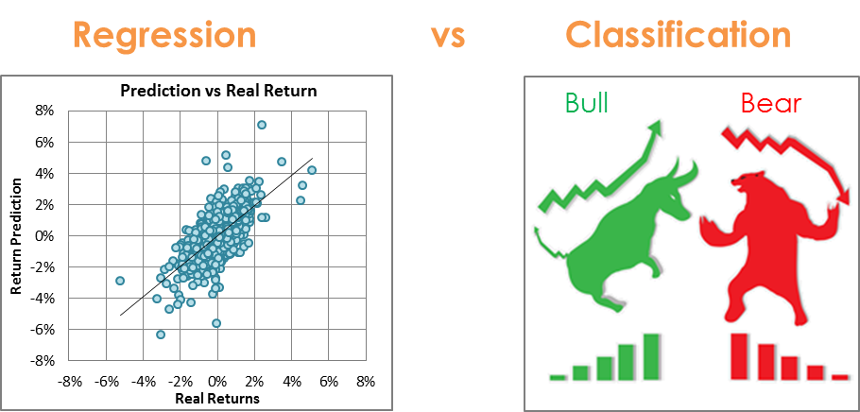
Supervised learning methods
https://quantdare.com/machine-learning-a-brief-breakdown/
Notes:
Real life examples - self-driving cars, spam filtering, amazon recommendations

Slide 43
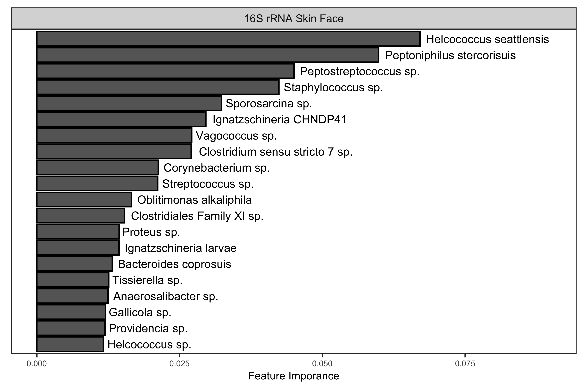
1
2
3
4
5
CMU
SHSU
UTK

Slide 44


Slide 45
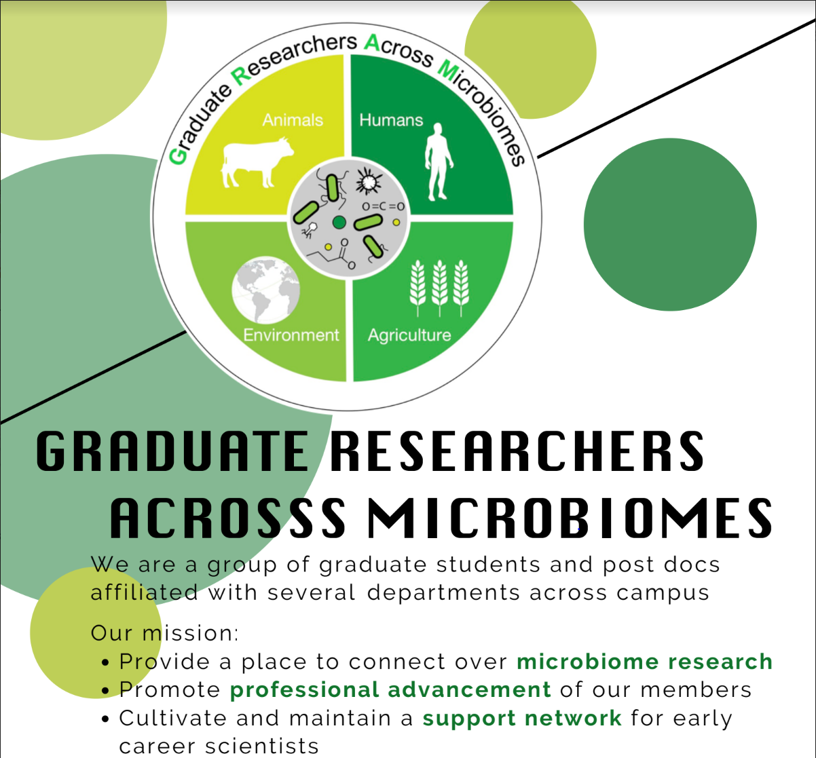

Slide 46
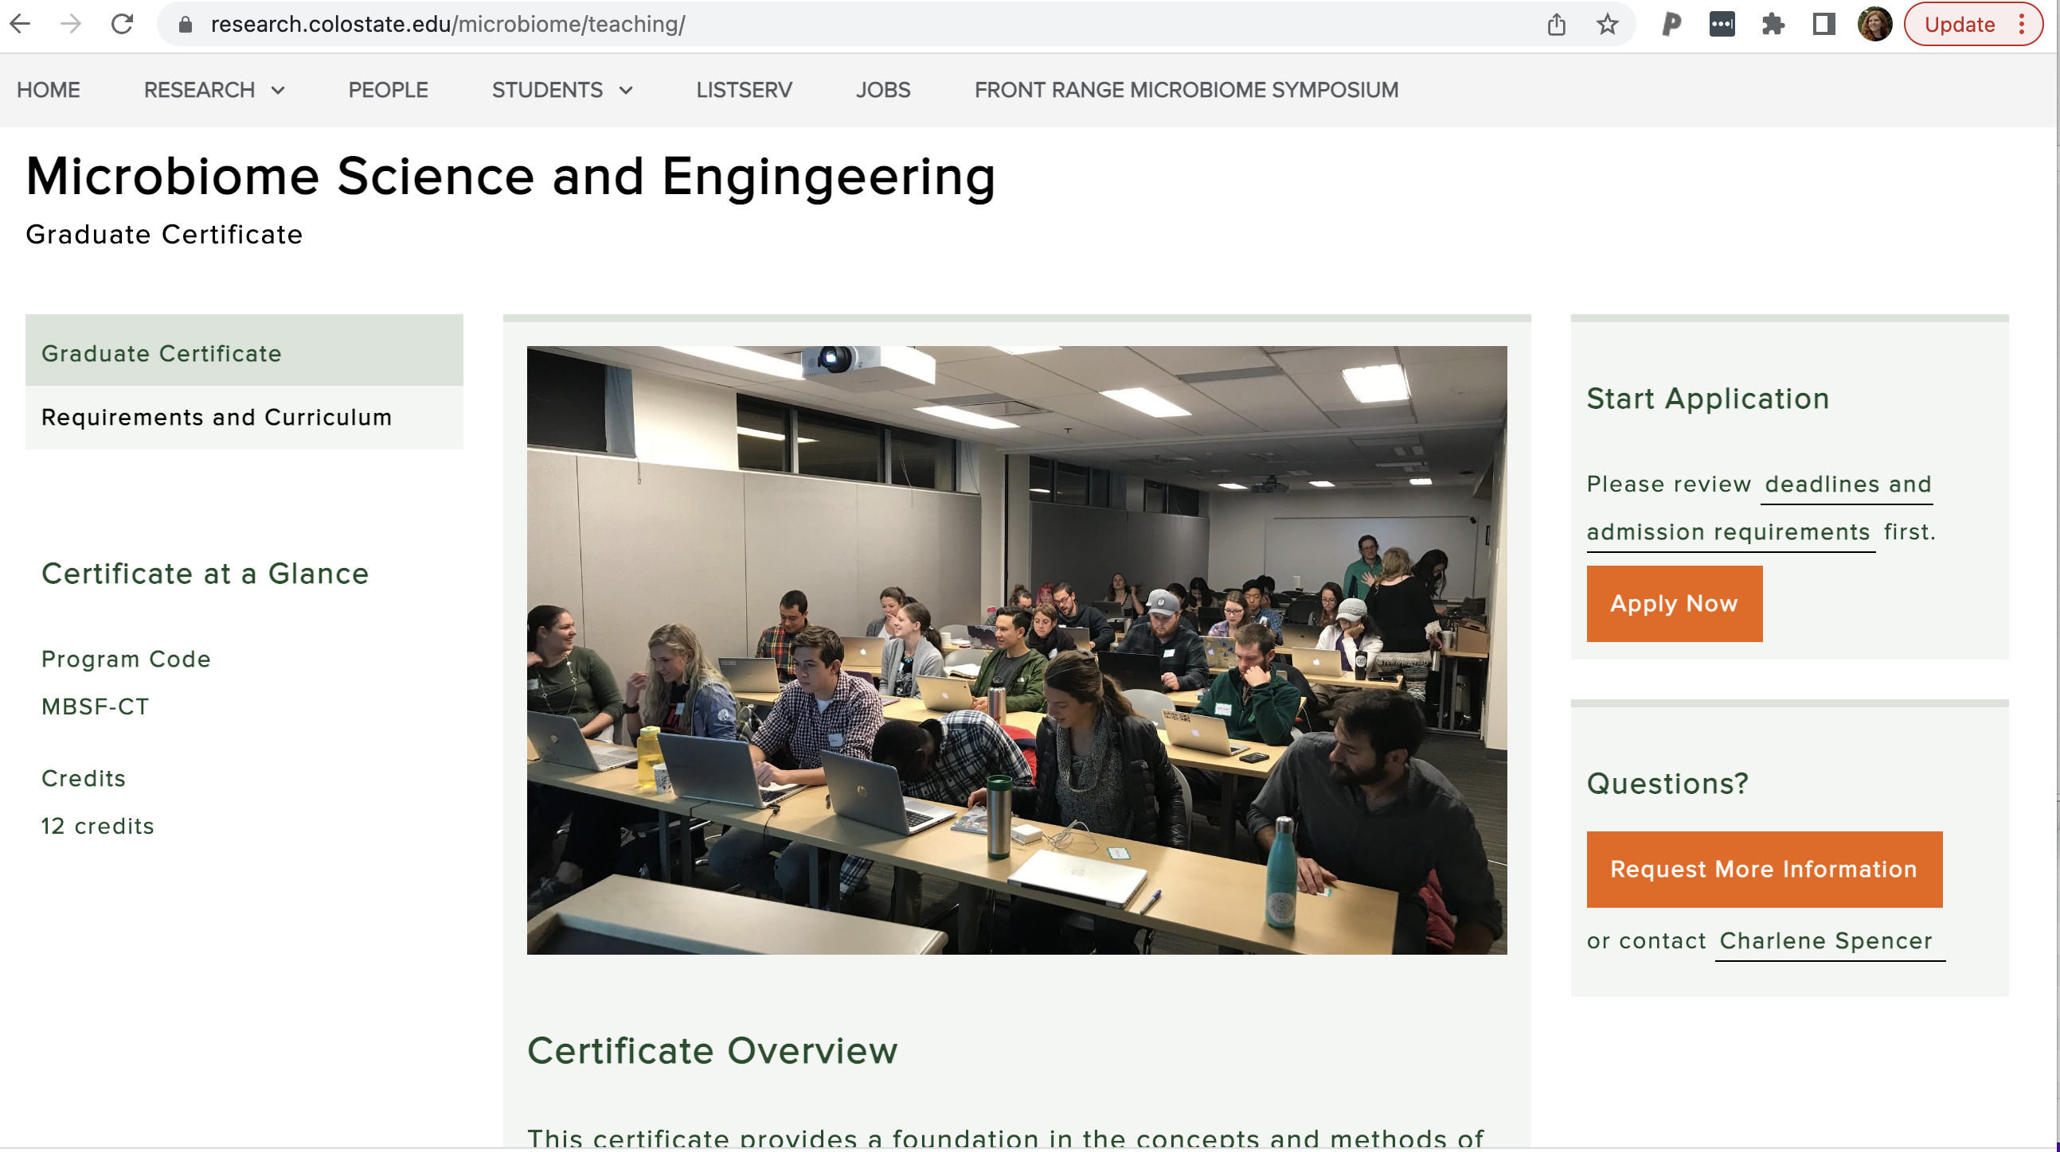

Slide 47
Useful links
https://www.research.colostate.edu/microbiome
https://www.research.colostate.edu/microbiome/teaching/
https://www.research.colostate.edu/microbiome/gram/
Twitter: @GRAM_CSU
https://frontrangemicrobiomesymposium.com/

